Slide 1
Team 16 - Safe AI-Powered Canvas Workflow Assistant
System Design Presentation
Capstone Project - AI-Assisted Canvas LMS Workflow Management
Presented by team 16

Slide 2





MEET THE Team
YERDANA MAULENBAY
MRIDUL NOHRIA
BAO TRAN
JESSICA GOEL
RHYTHM TRIVEDI

Slide 3
Project Purpose & Problem Statement
Instructors spend excessive time navigating Canvas for repetitive workflows
Tasks like missing submission tracking and messaging require multiple manual steps
Administrative overload reduces time available for teaching and student support
Goal: simplify workflows using conversational AI assistance

Slide 4
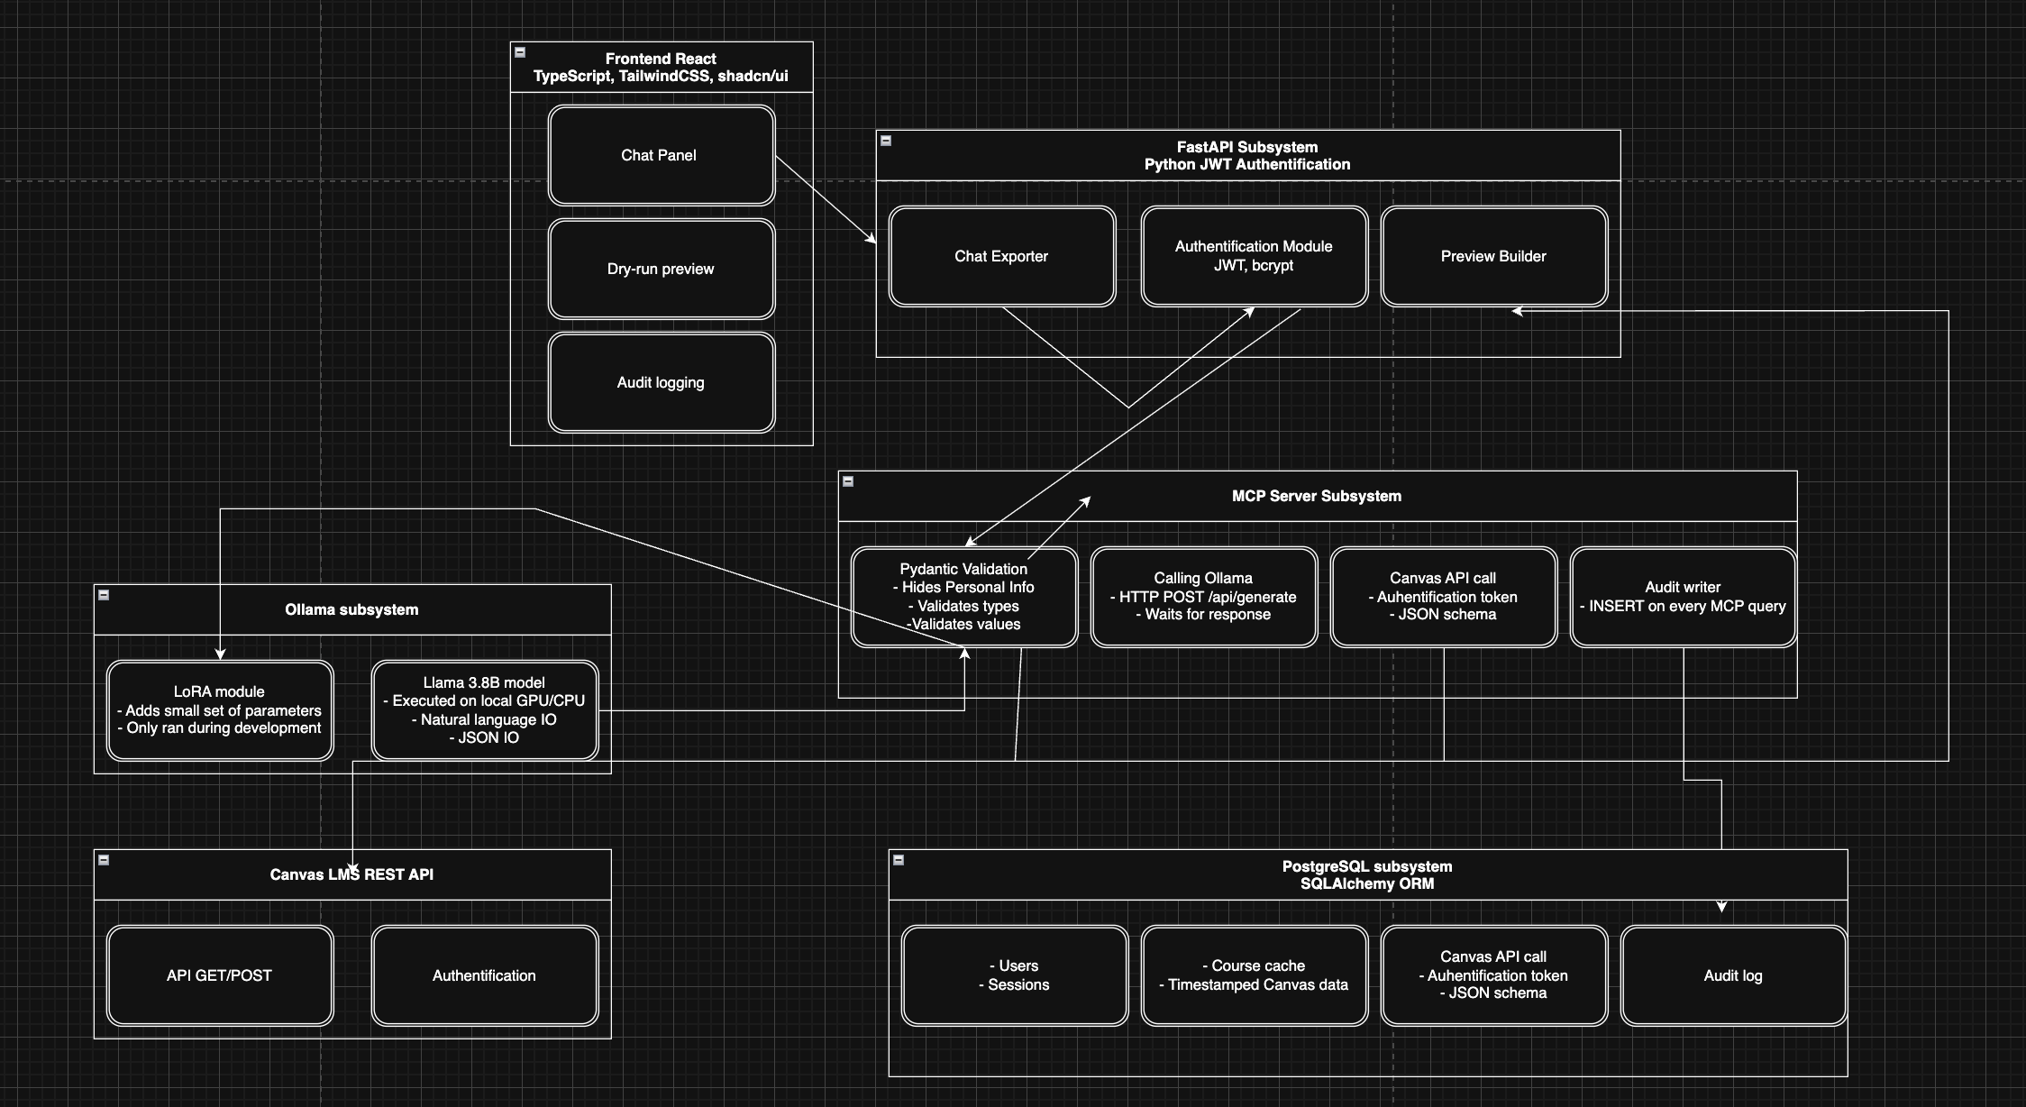
System Architecture
Frontend
React
TypeScript
Tailwind
Backend
FastAPI
MCP Server
Infrastructure
PostgreSQL
Ollama
Canvas LMS
Key design
decisions:
Local AI
Secure credential
boundary
Human approval
workflow

Slide 5
Architecture Rationale
Why this design?
Security
Canvas tokens never reach the LLM
Privacy
Local Ollama deployment
Reliability
Pydantic validation
Accountability
Audit logs

Slide 6
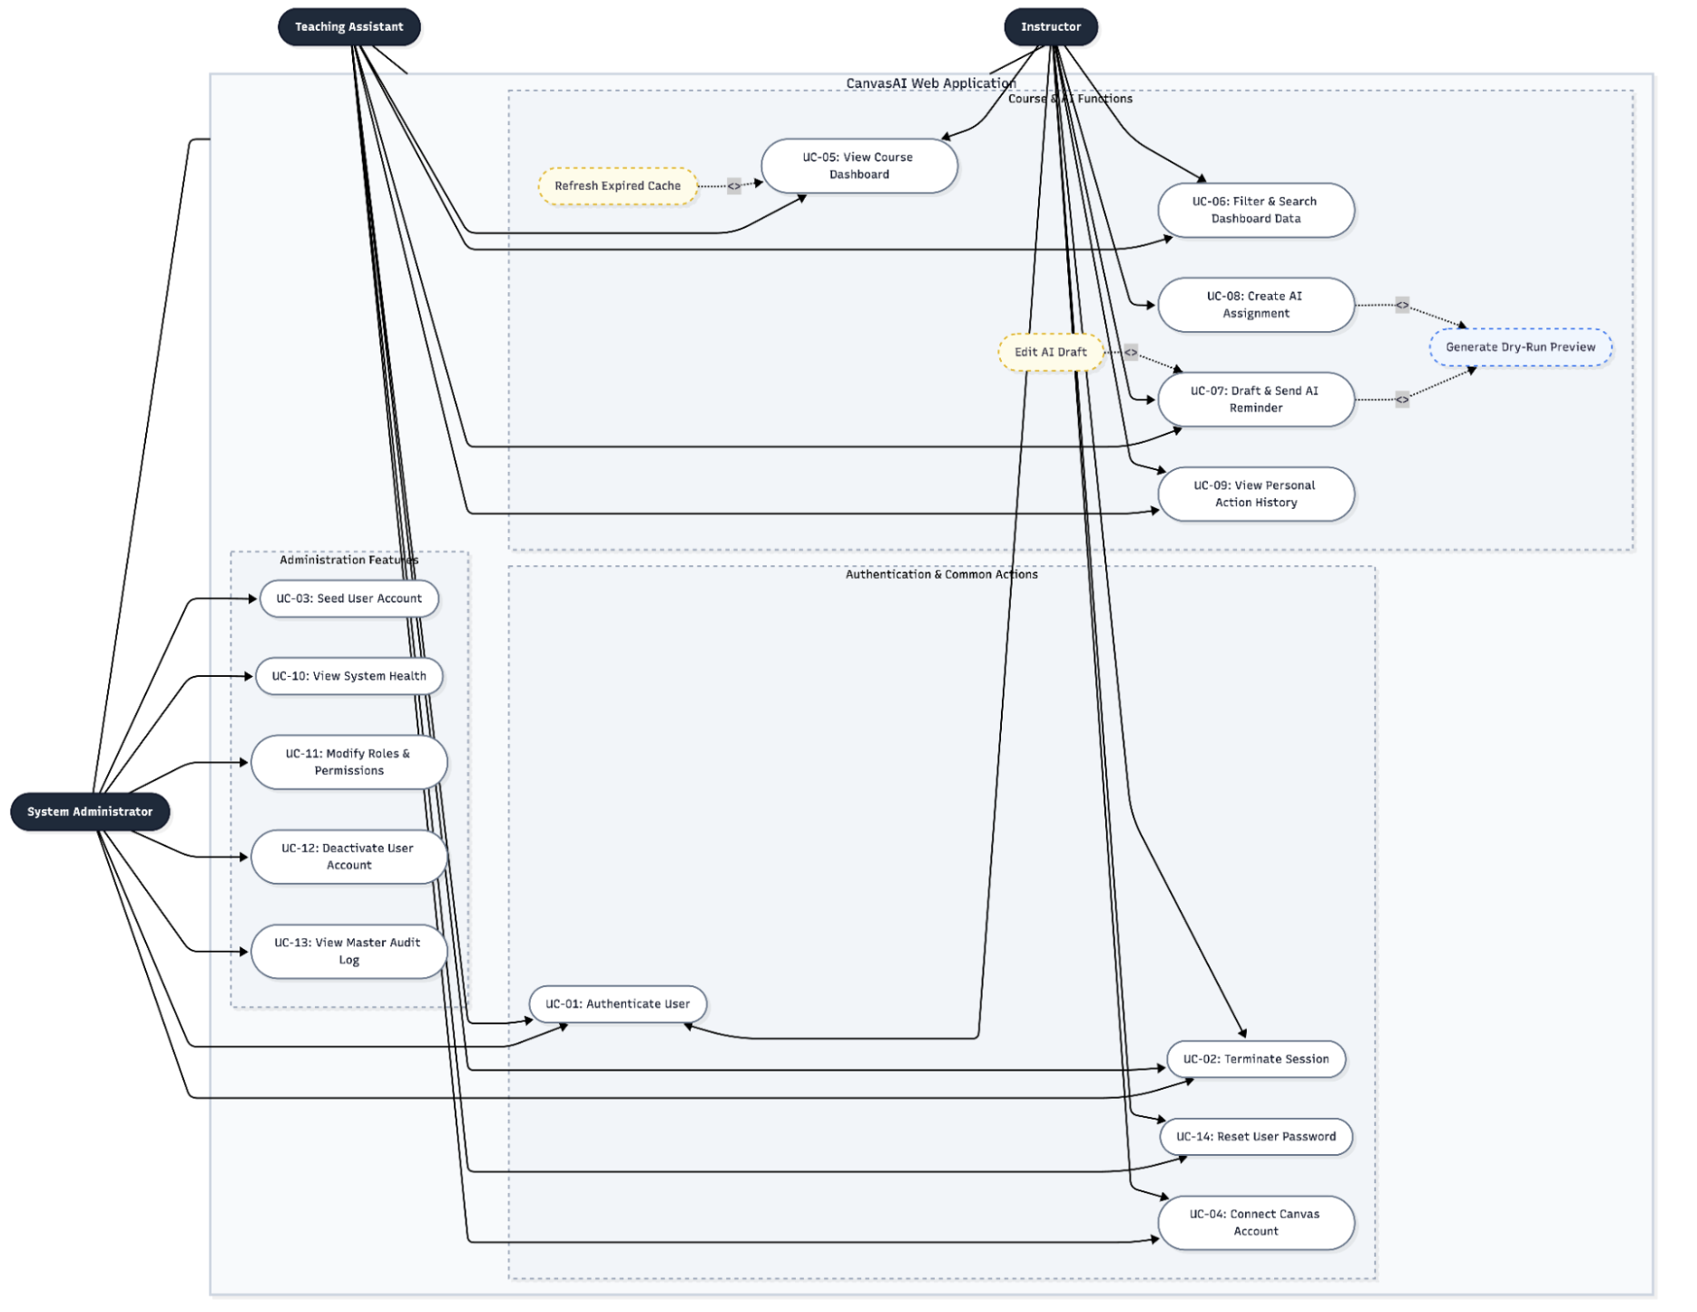
Use Case Diagram
Instructor
Create Assignment
Send Reminder
View Analytics
TA
Draft Messages
Monitor Students
Admin
Manage Users
View Logs

Slide 7
USE CASE WALKTHROUGH

Slide 8
Use Case 1
AI Reminder Messages
Instructor Prompt
Draft Generated
Workflow Preview
Approve
Canvas Message Sent
Audit Log Created

Slide 9
Use Case 2
AI Assignment Creation
Instructor Prompt
Assignment Draft
Preview
Publish

Slide 10
Use Case 3
Missing Submission Analysis
Canvas Data
AI Analysis
At-Risk Students
Recommendations

Slide 11
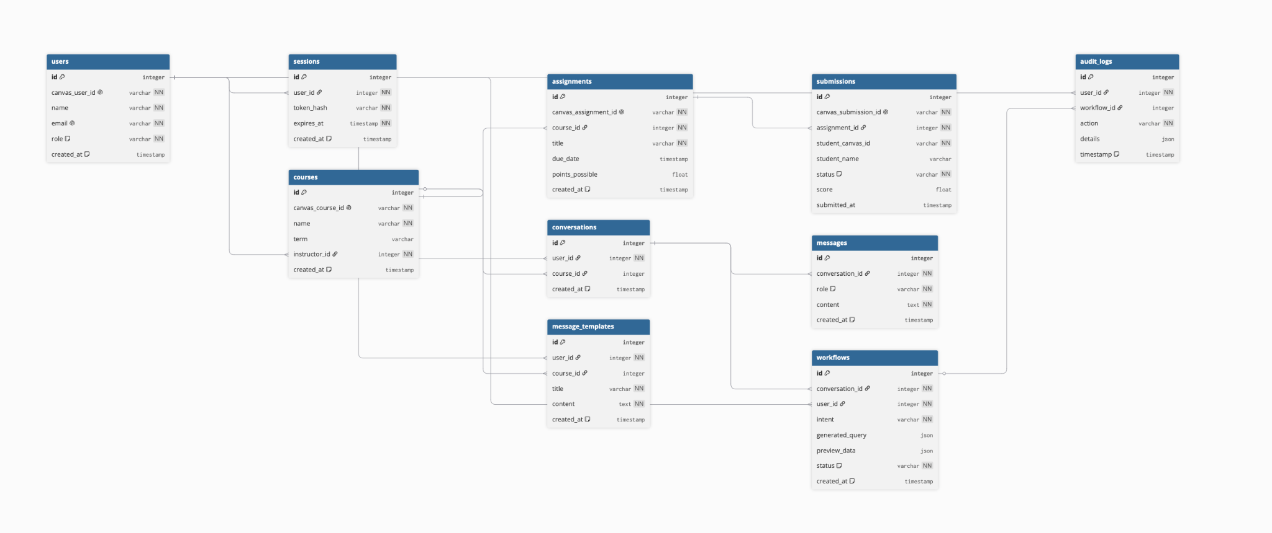
ER Diagram
Why this structure?
Supports:
Role management
Course tracking
AI conversations
Approval workflows
Auditability
The workflow and audit log tables enforce our human-in-the-loop design by ensuring all AI-generated actions are reviewed, approved, and traceable.

Slide 12
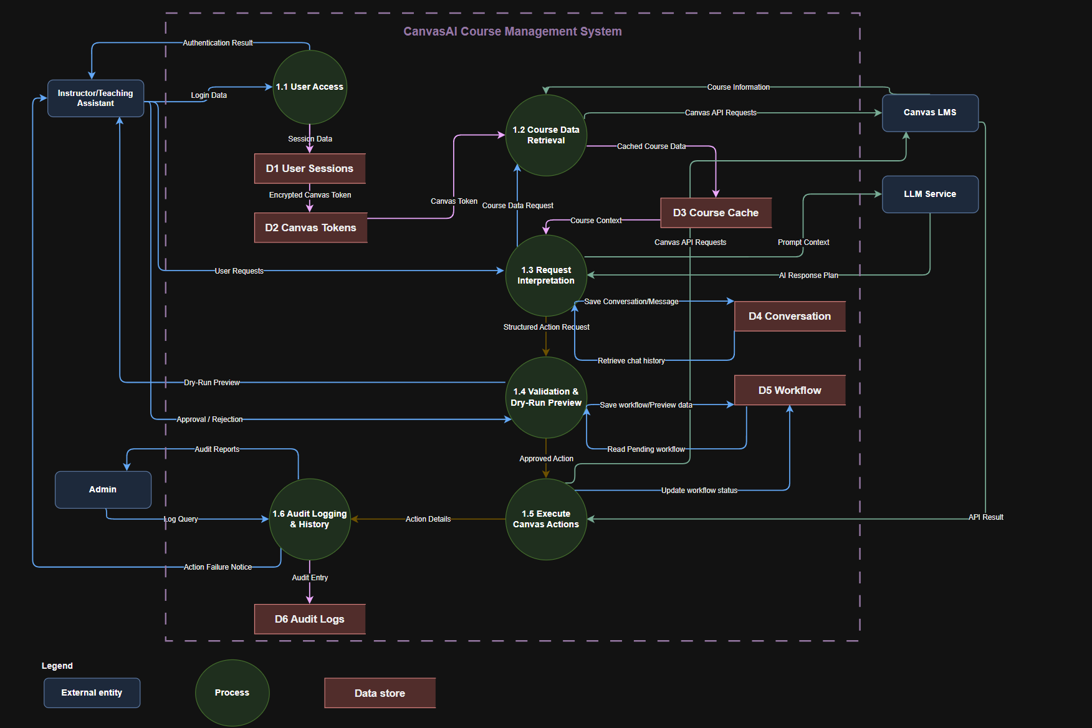
DATA FLOW DIAGRAM(L1)
Workflow
User Request
↓
AI Interpretation
↓
Validation
↓
Workflow Preview
↓
Approval
↓
Canvas Execution
↓
Audit Log

Slide 13
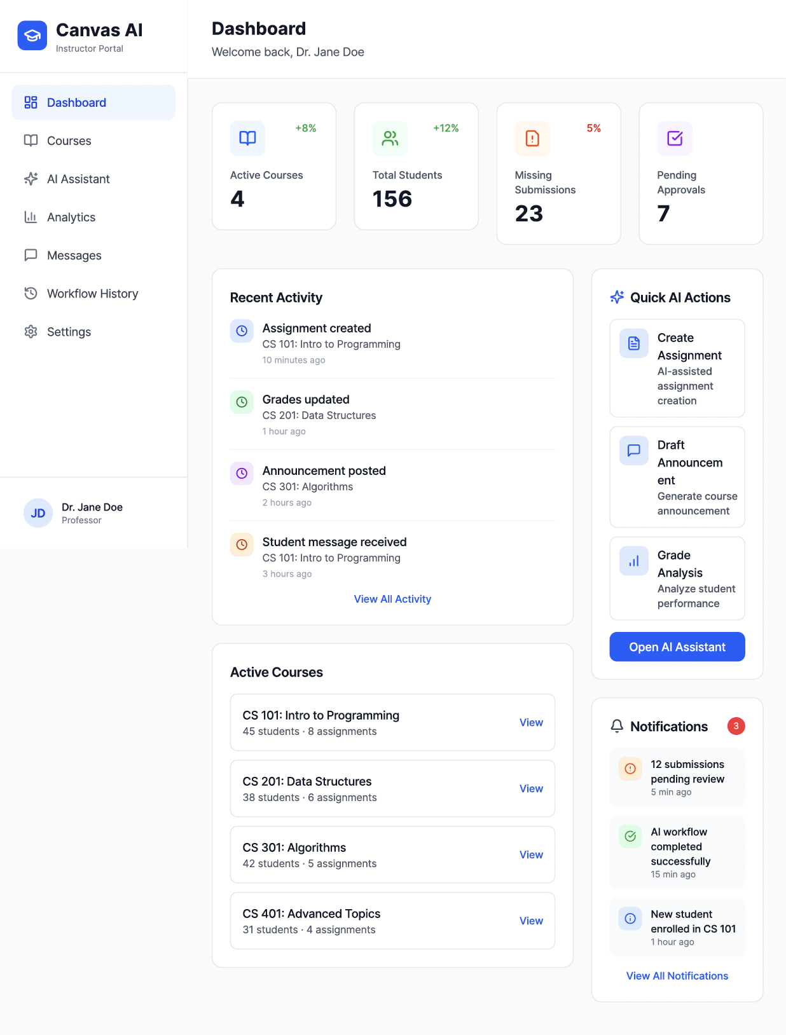
Instructor Dashboard

Slide 14
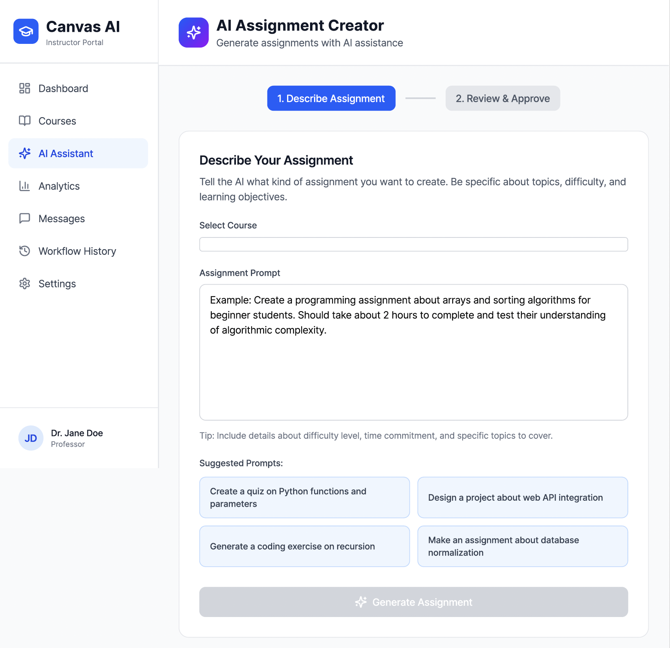
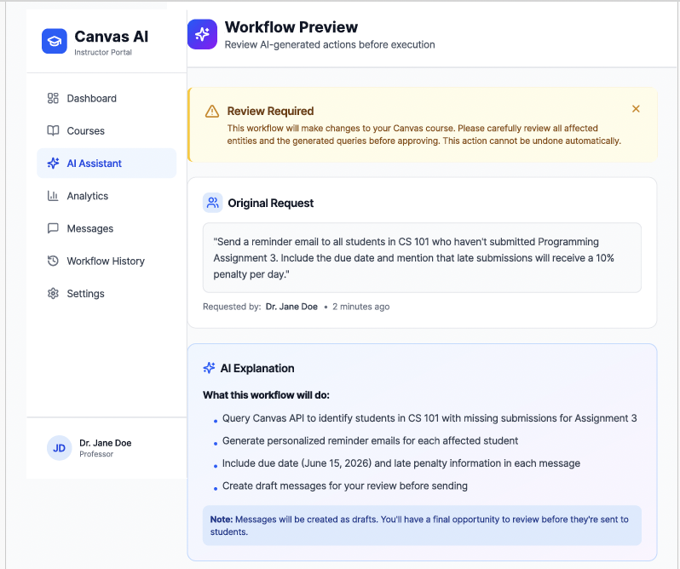
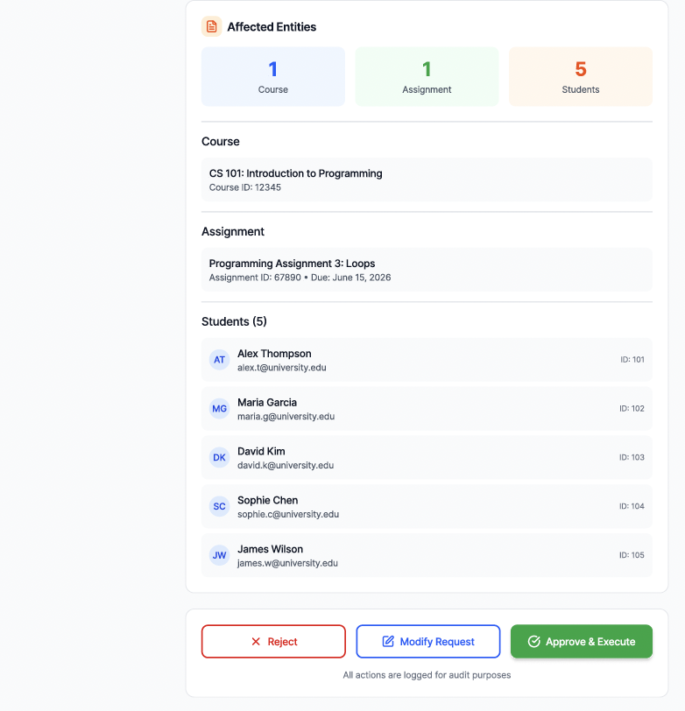
AI Assistant + Workflow Preview

Slide 15
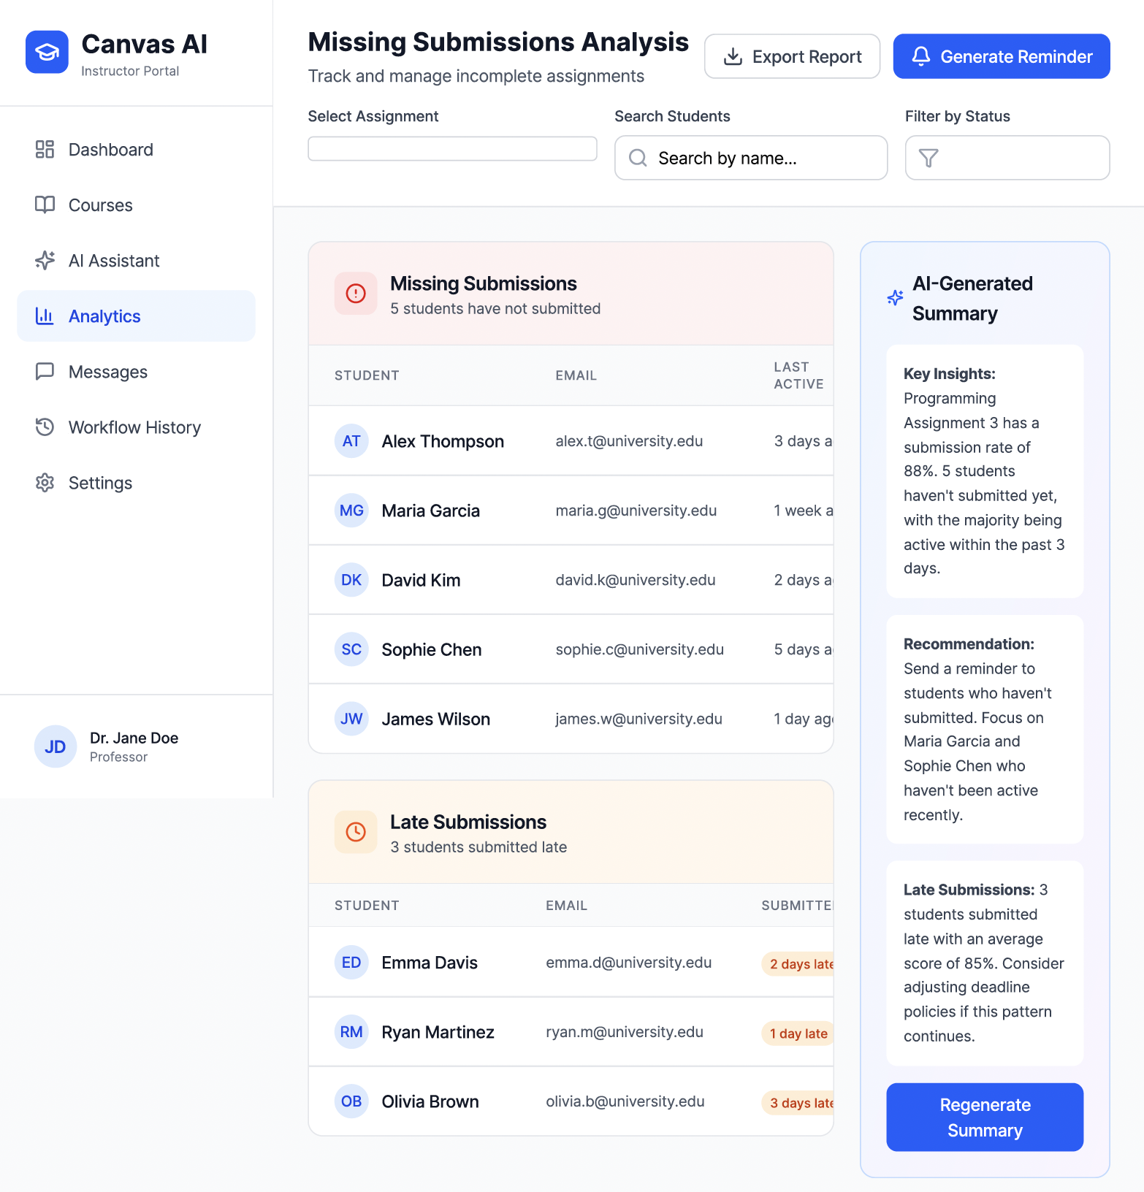
Missing Submission Analysis

Slide 16
Tech Stack + Conclusion
Design Decisions
✓ Local AI
✓ Human-in-the-loop
✓ MCP Security Boundary
✓ Audit Logging
Proposed Tech Stack
Frontend:
React
TypeScript
Tailwind
Backend:
FastAPI
Pydantic
Python
AI:
Ollama
Llama
Database:
PostgreSQL
A secure AI-powered assistant that simplifies Canvas workflows while maintaining privacy, transparency, and instructor control.

